Slide 1
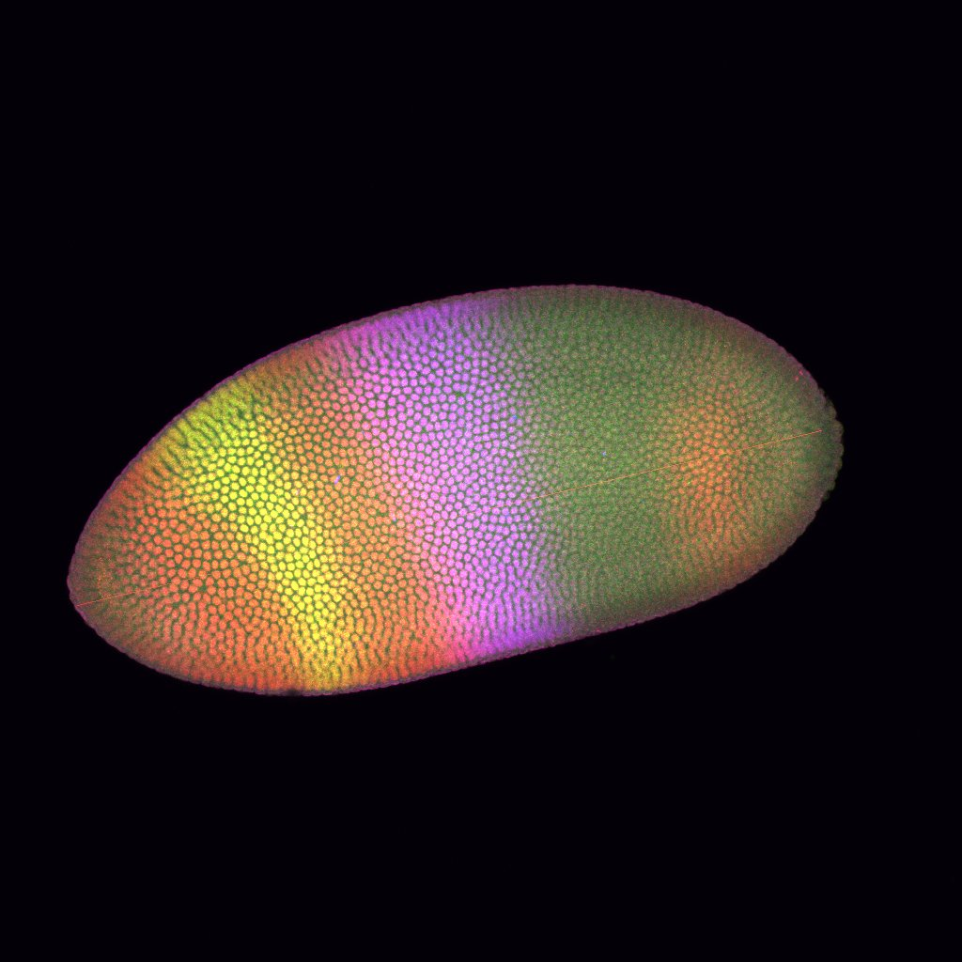
Quantification of Gene Expression Profile in Drosophila Embryos
APC 524
Zongjun Tan Ping Wu Guanhua He

Slide 2
Body Axis and Segmentation

Slide 4
Immunofluorescence

Slide 5
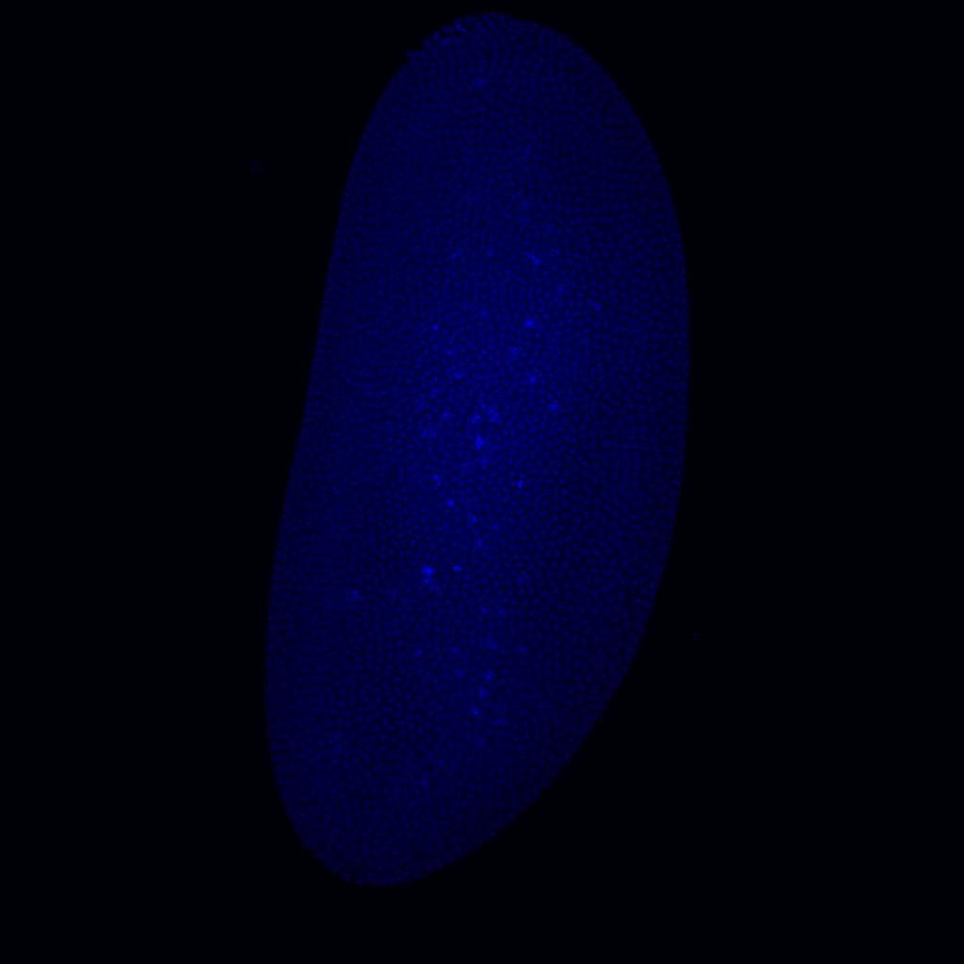
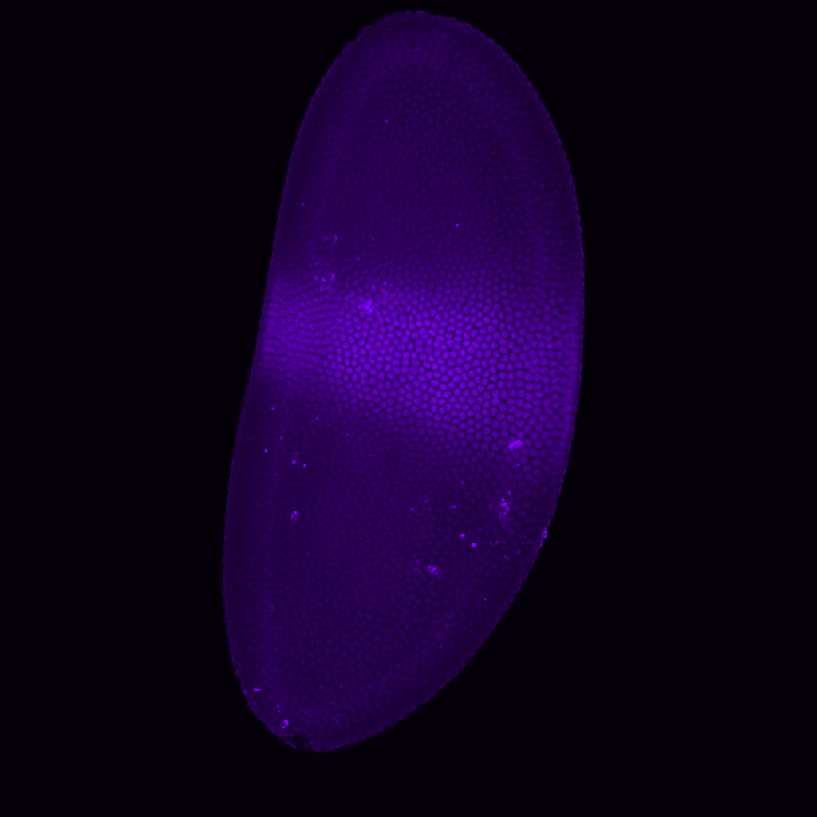
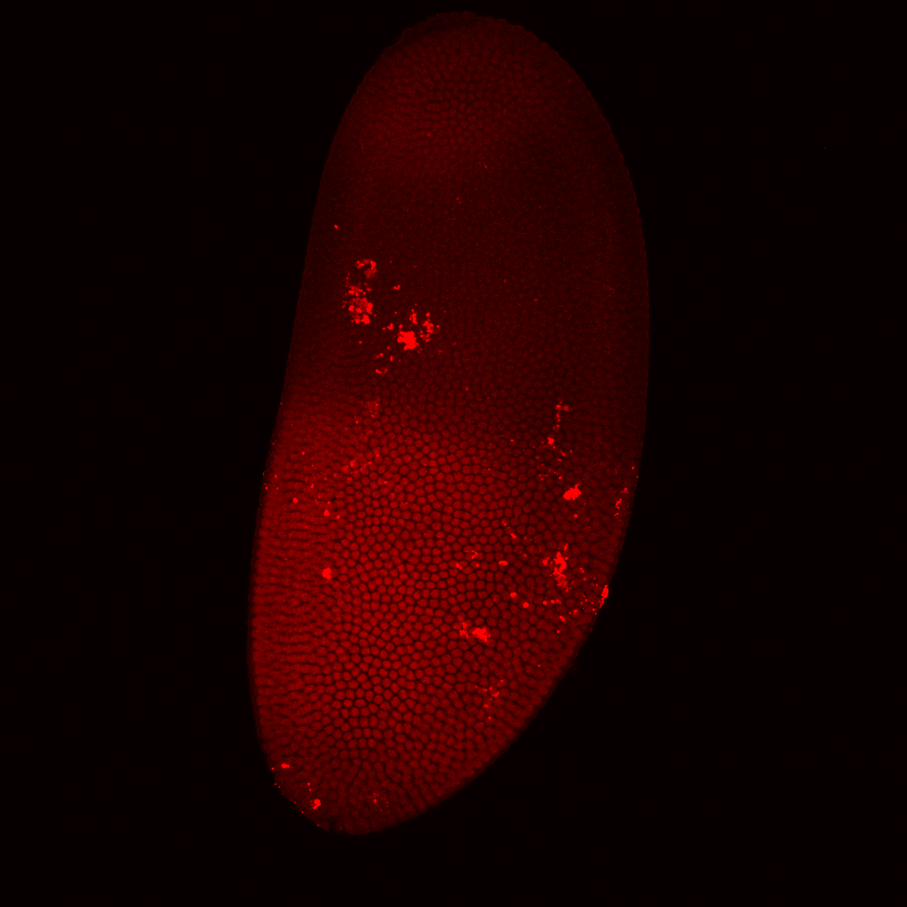
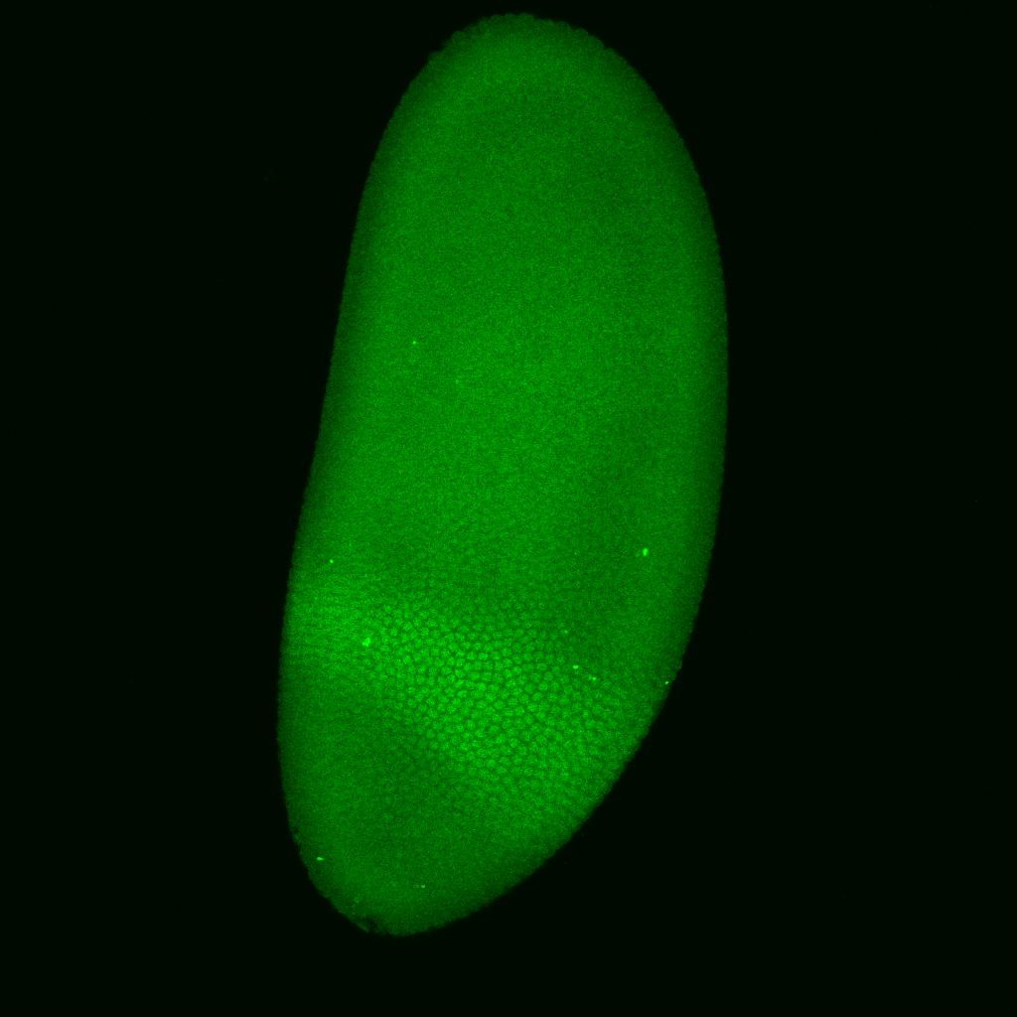
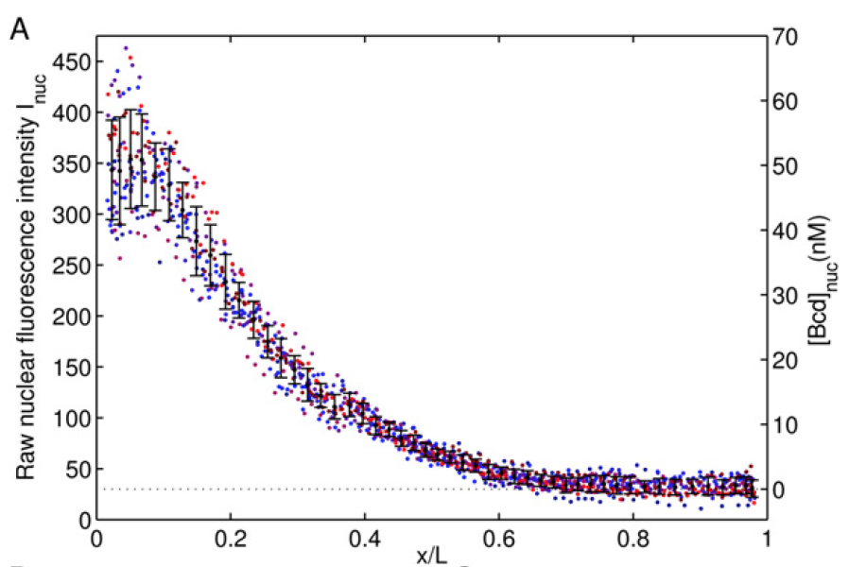
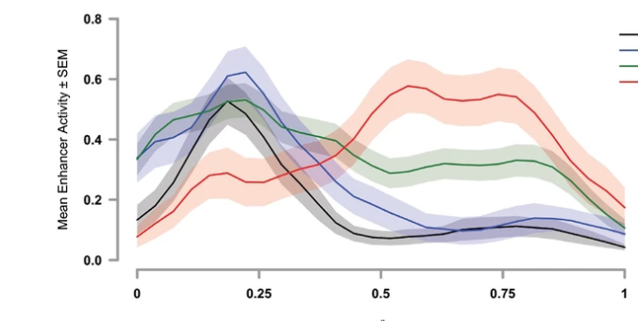
Notes:
Directly looking at those images , specifically where it is expressed and how much(intensity), need further quantification.

Slide 6
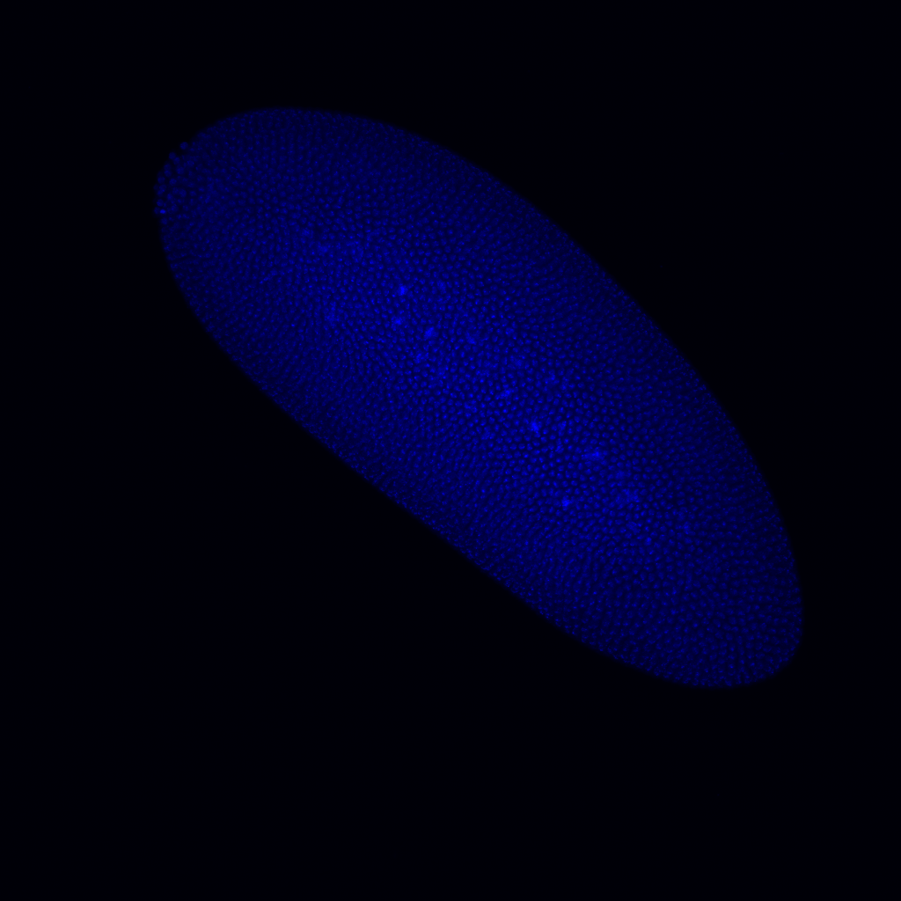

Slide 7
Notes:
Done mannually in a imaging analysis software. No consistent criteria, and when you have a large dataset, troublesome

Slide 8
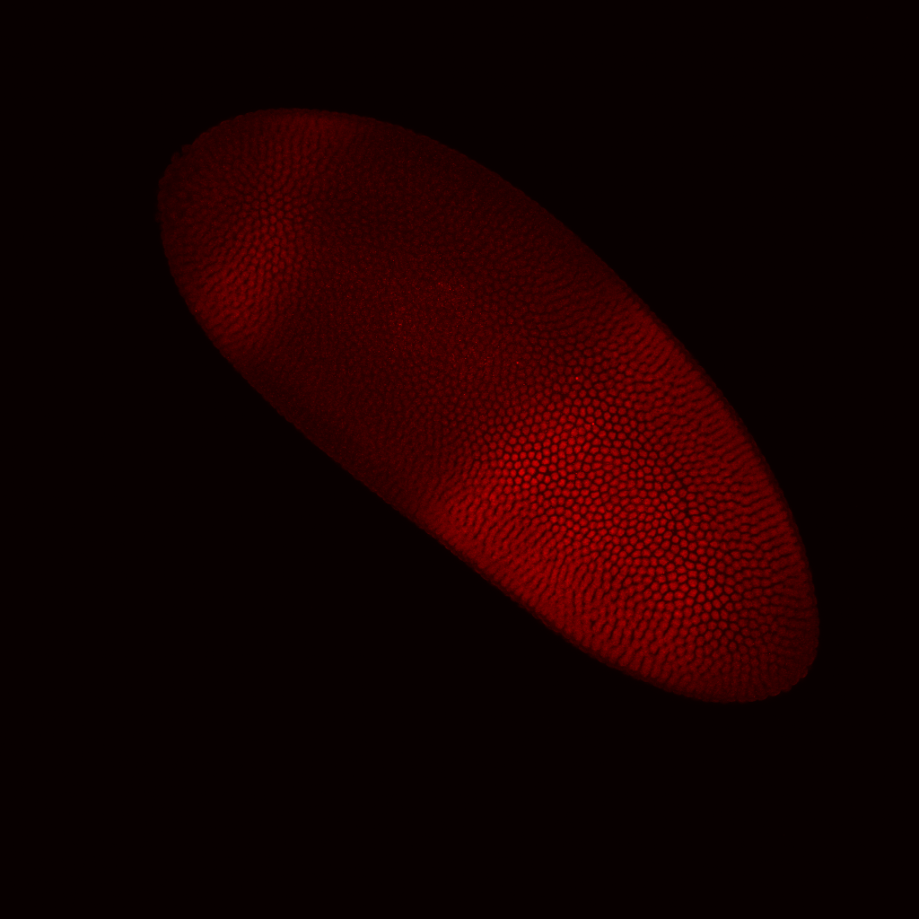
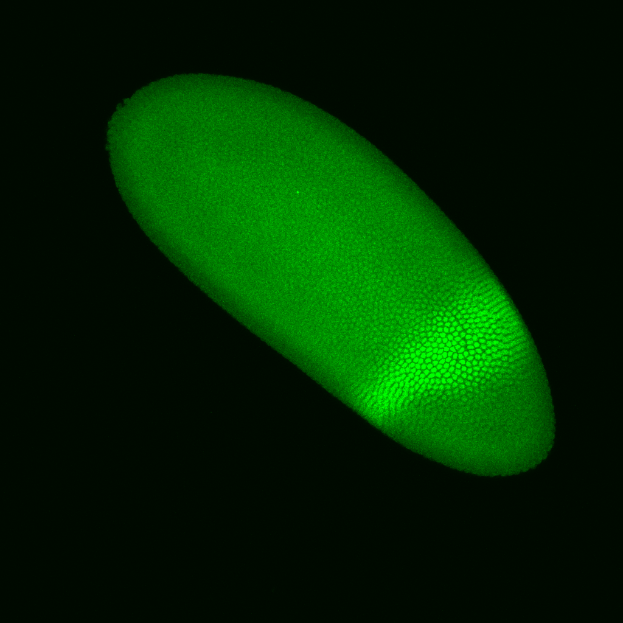
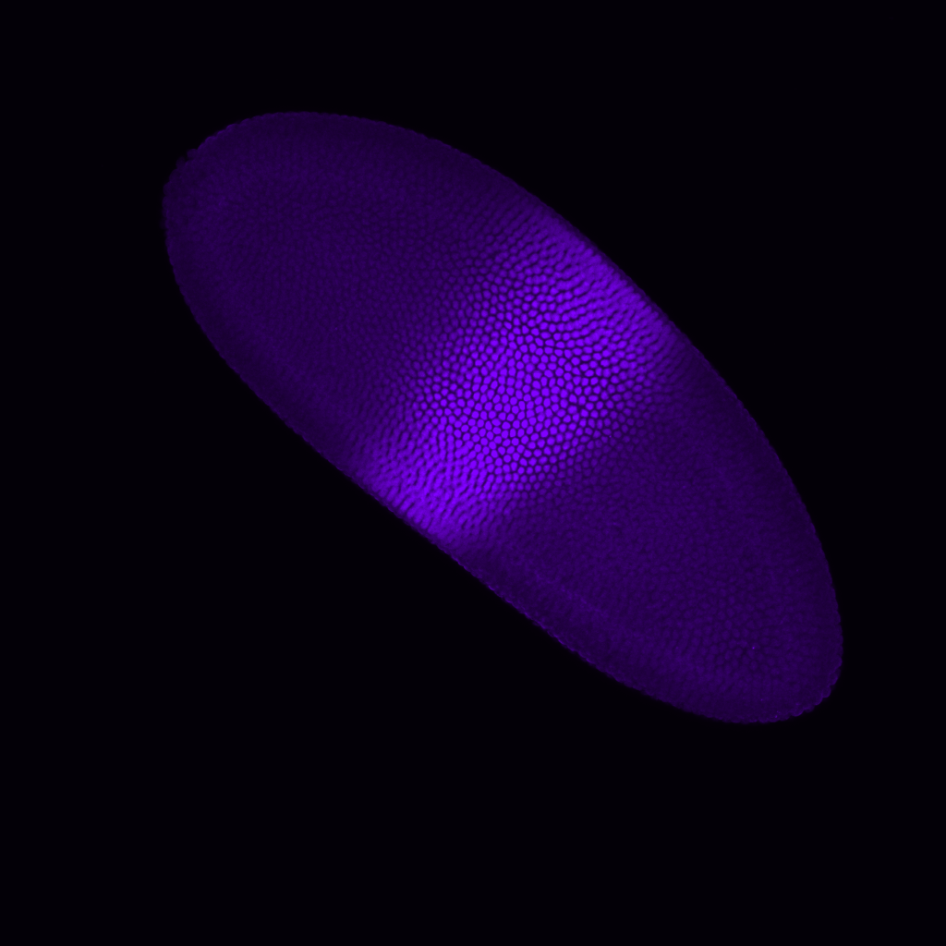
Notes:
Done mannually in a imaging analysis software. No consistent criteria, and when you have a large dataset, troublesome

Slide 9
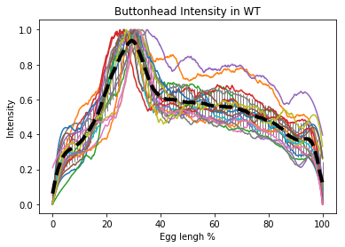
Boundary
Rotation
Embryo
Polygon
Intensity

Slide 10
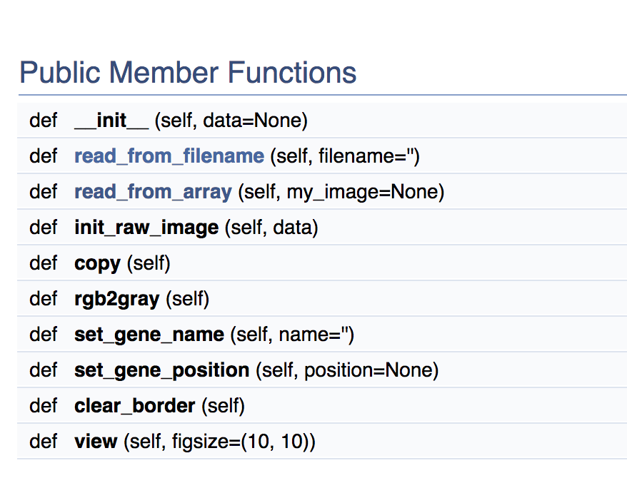
Embryo
Read raw images and convert to gray scale images and view them
file:///Users/pingwu/APC524_project_drosophila/version_1/documentation/html/class_embryo_1_1_embryo.html

Slide 11
Boundary – find contour, define head and tail
Skimage: find contour
Convex hull
Polar coordinate, calculate curvature

Slide 12
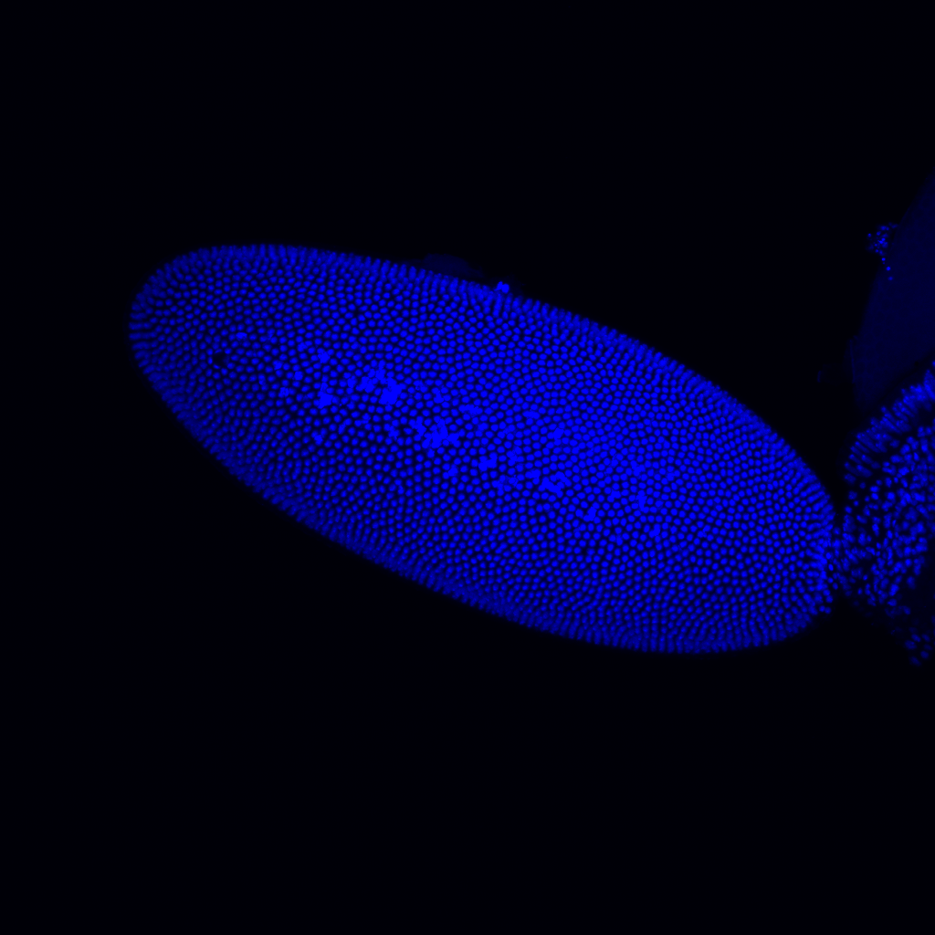
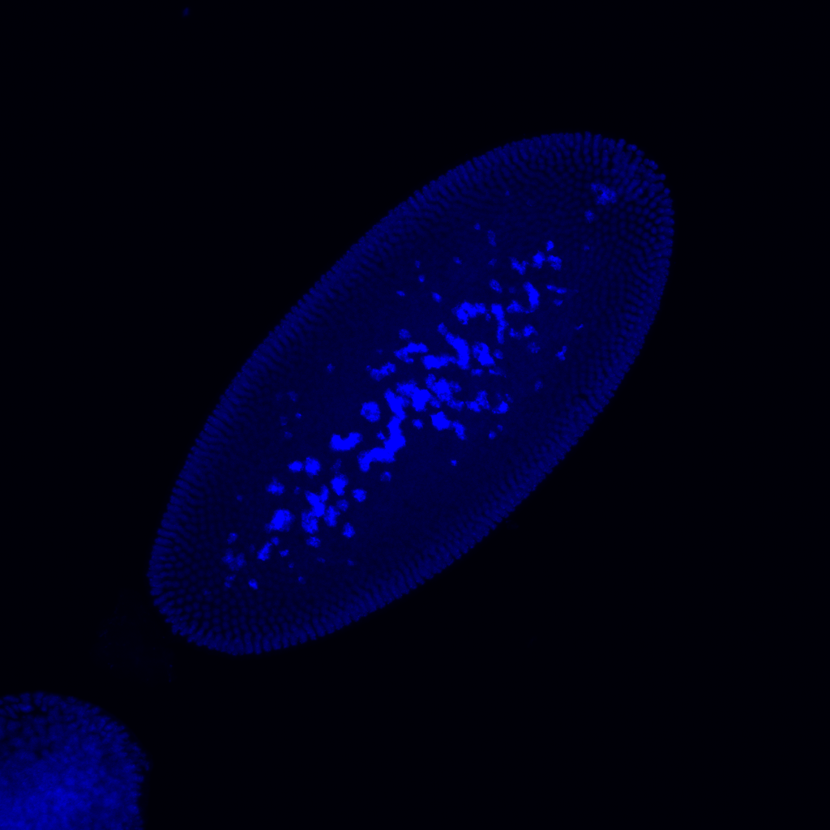
However…….

Slide 13
Solved!
find the largest contour
Use the contour image as input to find boundary

Slide 14
Boundary – PCA
Sklearn: PCA
file:///Users/pingwu/APC524_project_drosophila/version_1/documentation/html/class_boundary_1_1_boundary.html

Slide 15
Rotation
file:///Users/pingwu/APC524_project_drosophila/version_1/documentation/html/class_rotation_1_1_rotation.html

Slide 16
Polygon
file:///Users/pingwu/APC524_project_drosophila/version_1/documentation/html/class_polygon_1_1_polygon.html

Slide 17
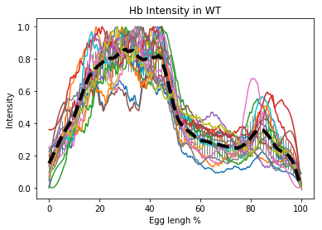
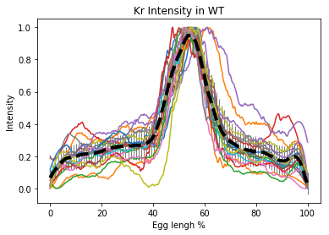
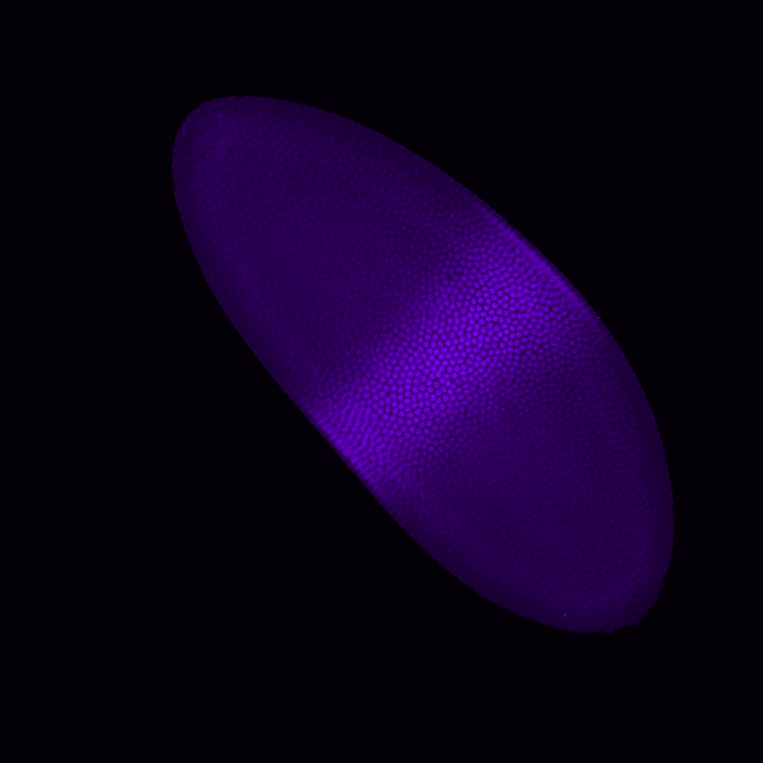
Intensity

Slide 18
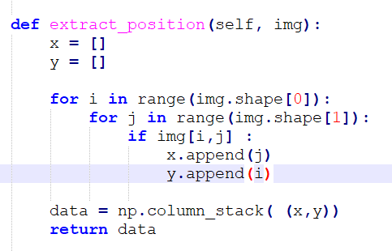
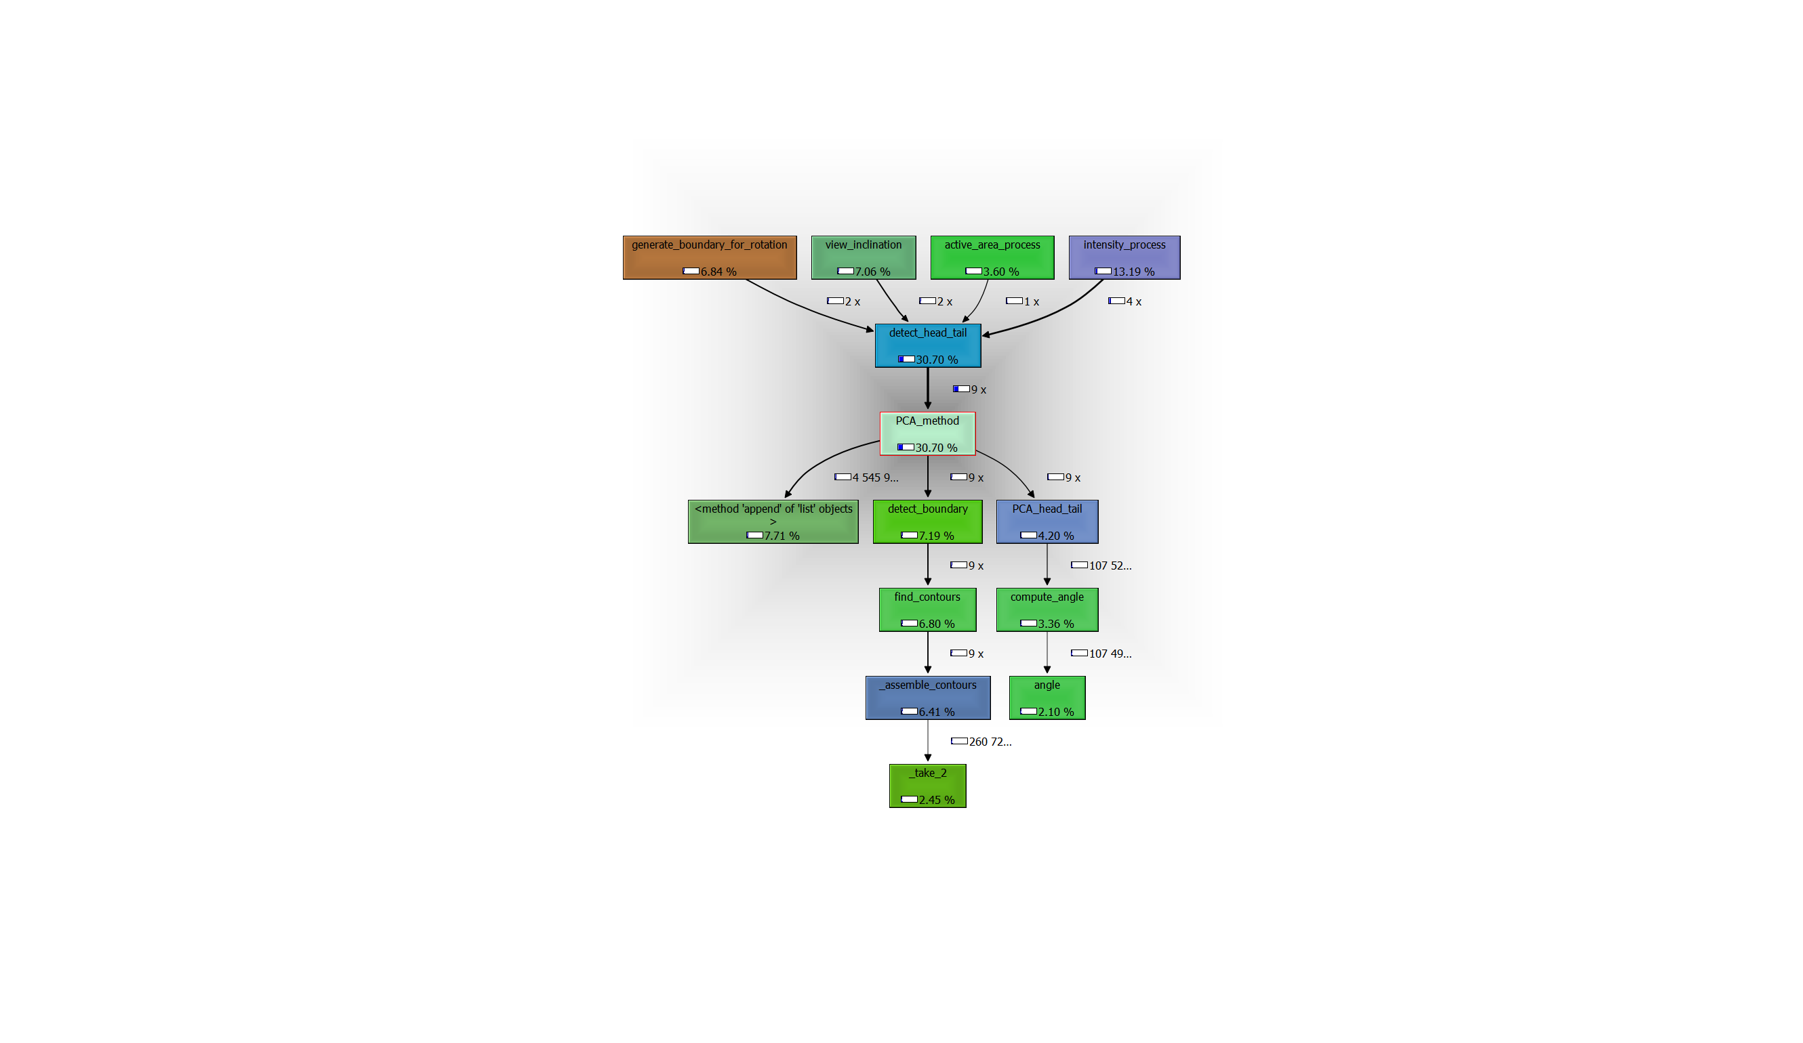
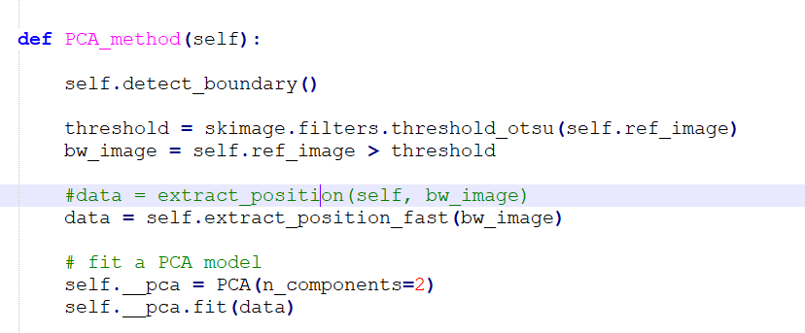
Profiling: cProfile & qcachegrind

Slide 19
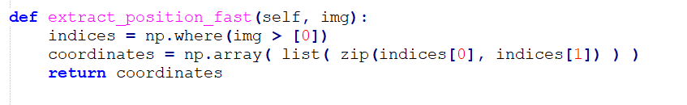
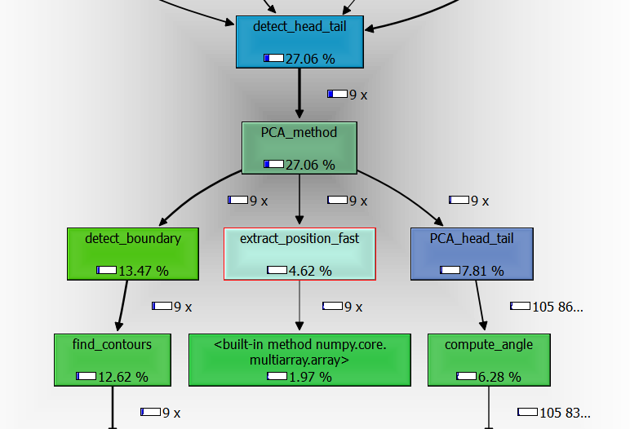
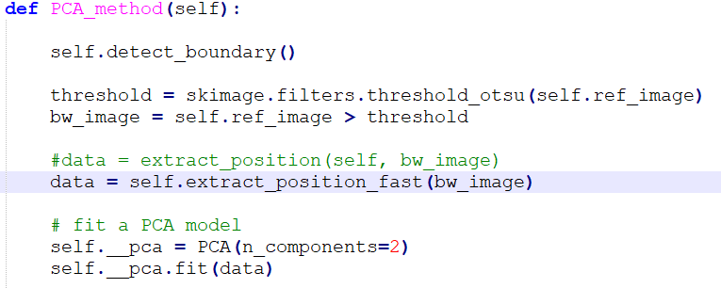

Slide 20
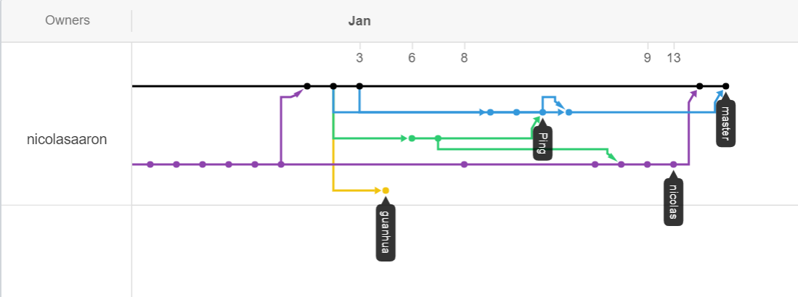
Gitgub network

Slide 21
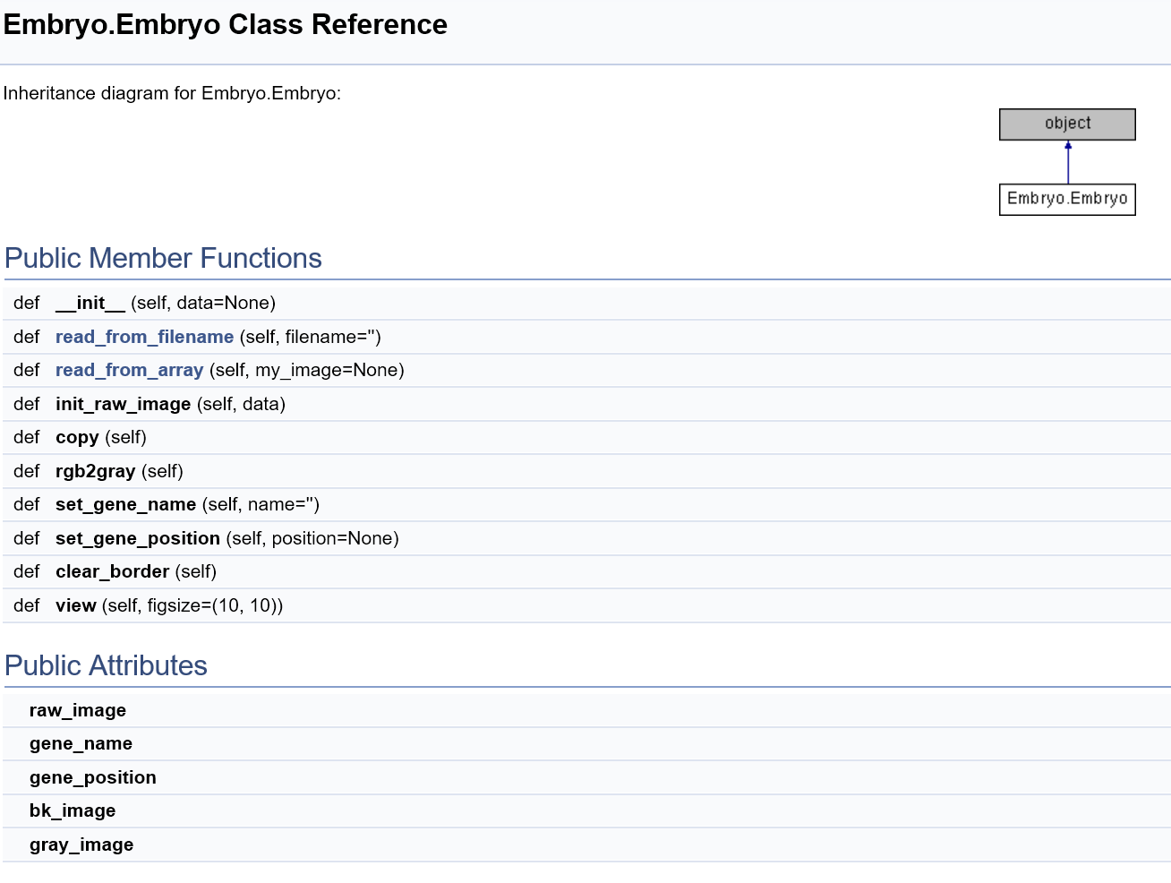
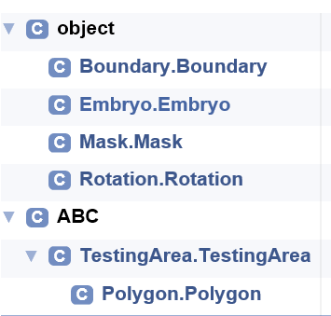
Documentation: Doxygen

Slide 22
Improvement
1. Only apply for anterior-posterior axis
Identification of dorsal and ventral polarity
Draw other area of interest (testing area)
2. Deal with more complicated scenario

